Slide 1
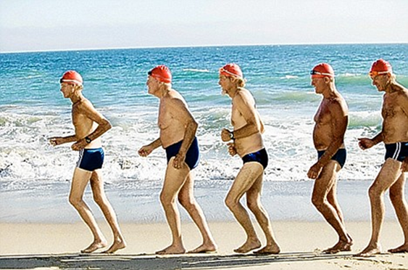
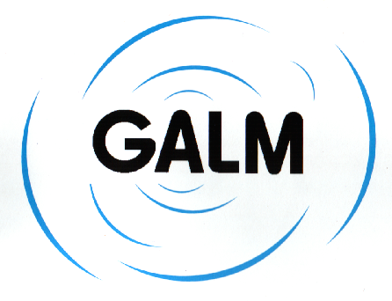



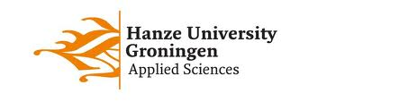
Groningen Active Living Model (GALM)
A health enhancing physical activity program for sedentary older adults in the Netherlands
www.galm.nl
Mathieu de Greef PhD Ger Kroes MSc

Slide 2
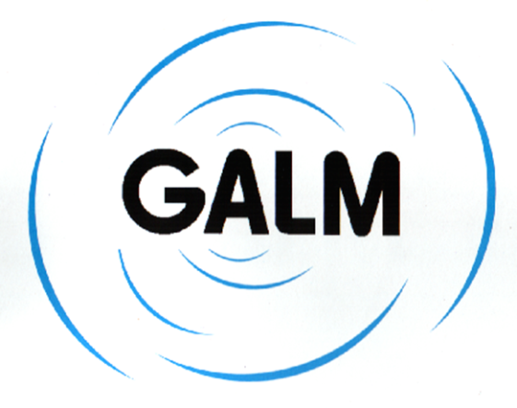
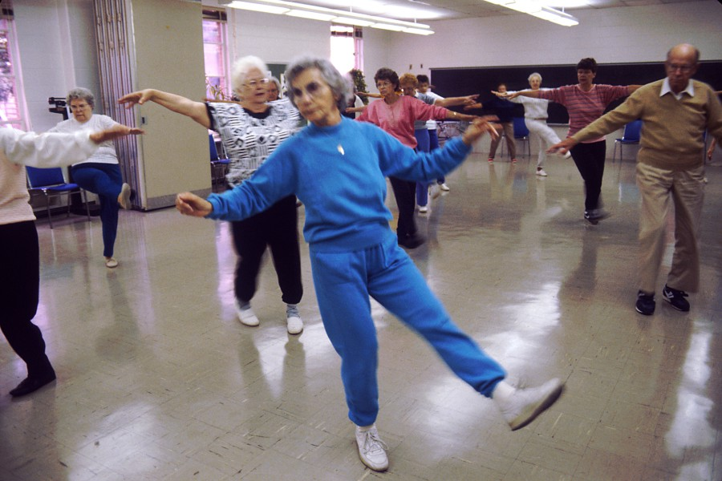

Features of the GALM program
focus sedentary older adults
aim to enhance physical activity to meet ACSM guidelines
age group 55-85 year
theory driven behavioral change as a multidimensional dynamic proces
orientation community based, recreational sportsprogram
Fit weekly 60 minutes, 30 months, moderate intensity

Slide 3

GALM conceptual model
1
2
3
4
-Social Cognitive Theory
-Evolutionary play Theory
-Toronto Model
Active Ageing
Recruitment
Adoption
Behavioral change
Stage
(2 months)
(4 months)
(12 months)
(12 months)
Campaign activities
Home visits
Exercise introduction program
Group tailored exercise class
Selfmanagement training
Behavioral change mechanisms
Motivational climate
Enhancing fitness, skills & connectedness
Adherence and Social participation
Enjoyment
Theoretical concepts
+
+
-Transtheroretical Model - Self-Determination Theory - Nudge Theory - Active living concept
+
-Schema theory -Health Literacy framework -Relapse Prevention Theory
- Goalsetting Theory - Social connected-
ness theory

Slide 4


Theoretical framework GALM
Recruitment and adoption
Behavioral change
Active Ageing
Health Literacy theory
Health education
Social Marketing Theory
Self determination theory
Expected pleasure theory
Marketing mix
motivation
Toronto Model; Play theory
Social Cognitieve theory
Fysical fitness
Self-efficacy
Resilience theory
empowerment
Nudge Theory
Schema theory
nudging
enjoyment
engagement
Self determination theory
adherence
Relapse Prevention Model
Social Capacity Theory
Active Living Model
Transtheoretical Model
compliance
Social connectedness
Social capital theory
Community based
PA status
social participation
Social Cognitieve theory
Social support

Slide 5

Linkage theoretical framework GALM to the Socio-ecological model
Health literacy framework
Social Marketing Theory
Active living Model
Totonto model
Social Capital Theory
Resilience Theory
Social cognitive Theory
Transtheoretical Model
Scheme theory
Self Determination Theory

Slide 6
The effect on behavioral change
20%
18%
24%
16%
14%
Interested fittest intro program after 18 mo after 30 mo
Popkema & de Greef 2000,

Slide 7
percentage of fitness scores below average

Slide 8

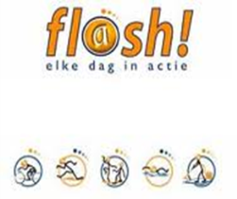


Development and dissimination GALM
European Health Promotion Award 2001
Differentiation
GALM
Sedentary elderly
SCALA
Sendentary elderly wiih chronic conditions
SMALL
DPA program sedentary elderly
Social Vitality
Healthy Ageing program sedentary and lonely elderly in deprived neighbourhoods
GALM-ADL
ADL campaign frail elderly in nursing homes
902 local projects
dissemination
2 local projects
1995
1999
2003
2007
Netherlands on the move
FLASH PA Campaign
National Actionplan
Sportsimpuls
National Health enhancing PA campaigns

Slide 9
matrix organization structure GALM
National level
Regional level
Local level
Local
project
Method
Funding
Monitoring
R&D
Training
Funding
Fitness test
Selection targetgroup
Network formation
Run GALM program
Funding
Continuity
- GALM foundation
- University Groningen
National Institute for Recreational Sports and Physical Activity (NISB)
Ministry of Health, Welfare and Sport
Netherlands Organization for Health Research and Development (ZonMW)
- Vocational Education Institutions
- Regional Sports Councils
- Provincial boards - Regional Health Services (GGD)
-Municipality
- Local sports and welfare organisations
- Local care institutions
- Member organisations for seniors

Slide 10
Theory
Program
Implementation
Evidence
summary
GALM is theory driven health enhancing physical activity strategy
Recruitment: 18% of sedentary older adults
Increase physical fitness (stength, endurance)
Feasible for euopean implementation

Slide 11


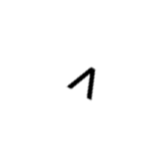

GALM-ECO model enhancement physical activity
resilience
Health information
MINDSETTING
Energy expenditure
Intrinsic motivation
active living
NUDGING
Social marketing

Slide 12



